Slide 1

Dynamic Graph Network Optimization
(Implementing SOSP And MOSP)
Usman Nadeem I212985
Muhammad Nehal i212998

Slide 2
Problem Statement
Challenges
Our Parallel Solution
Dynamic Graph Challenge: In large-scale networks, frequent updates (like edge insertions) make full re-computation of multi-objective shortest paths (MOSP) inefficient.
To handle real-time updates in massive dynamic graphs efficiently, we propose a parallel solution that combines MPI, OpenMP/OpenCL, and METIS for scalable and incremental MOSP updates.
Scalability Limitation: Traditional sequential approaches fail to meet the performance demands of real-time, high-volume data in large graphs.

Slide 3

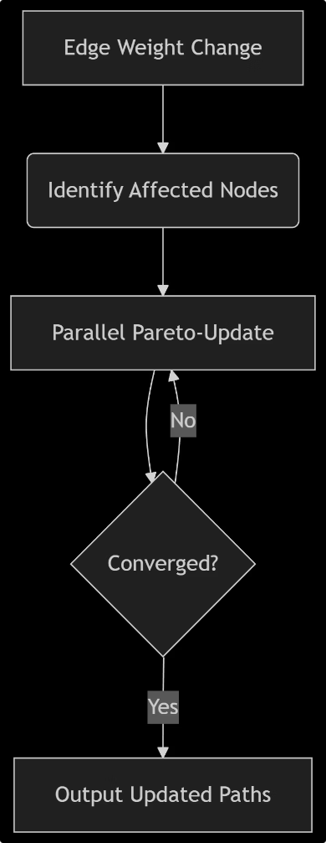
Paper Summary
SOSP (Single-Objective Shortest Path): A shortest path problem that optimizes a single objective in a graph.
MOSP (Multi-Objective Shortest Path): An extension of SOSP that finds optimal paths considering multiple objectives in a graph.
Paper Summary: The paper presents a parallel SOSP update algorithm, a heuristic MOSP update strategy for dynamic networks, and shared-memory parallel implementations optimized for scalable computation of SOSPs and MOSPs.

Slide 4


Key Contributions Of The Paper

Slide 5

Parallel SOSP Update Algorithm
Parallel SOSP Update Algorithm
Heuristic Approach for MOSP
Shared-Memory Parallel Implementation
The paper introduces an efficient parallel SOSP update algorithm using grouping techniques to reduce the total iteration count, improving scalability for large dynamic networks.
A heuristic algorithm is proposed to quickly update a single MOSP in large networks under time-varying dynamics, providing a practical solution for real-time applications.
The paper develops shared-memory parallel implementations that optimize SOSP and MOSP computations, leveraging multi-core architectures for scalable performance.

Slide 6

Tools Used
Tools
Role
METIS
Partitions graph to minimize edge cuts to reduce communication.
MPI
OpenMP
Distributes partitions and handles inter-process communication.
OpenCL
Parallelizes path computations within each node using multithreading.
Offers GPU acceleration for intensive Pareto-frontier updates.

Slide 7
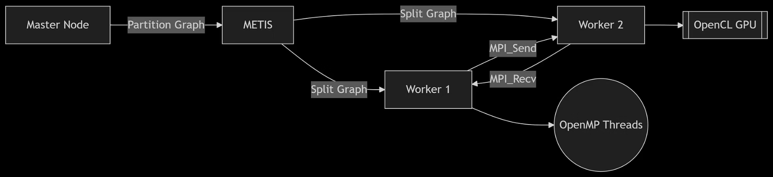
System Architecture

Slide 8
Implementation Plan And Workflow
Graph Partitioning
1
METIS partitions the large graph into smaller subgraphs minimizing edge cuts.
2
Task distribution (MPI)
Each partition is assigned to an MPI process for parallel execution with minimal communication.
Intra-Node Computation (OpenMP/OpenCL)
3
Each node updates SOSP/MOSP locally using OpenMP threads or GPU via OpenCL.
4
Pareto-Optimal Update & Synchronization
Update MOSP solutions and synchronize affected nodes across partitions.

Slide 9

Proposed Parallel Strategy
The proposed strategy combines graph partitioning, distributed computing, and multithreading. Below is the pseudo code:
G = load_graph()
Parts = METIS_Partition(G, P)
MPI_Init()
rank = MPI_Comm_rank()
LocalG = Parts[rank]
#pragma omp parallel for
for node in LocalG:
update_SOSP(node)
MPI_Allgather(updates)
if GPU_enabled:
launch_OpenCL(update_Pareto)
MPI_Finalize()

Slide 10





Expected Results
Strong Thread Scaling
OpenMP scales well from 1 to 64 threads. Speed increases for different Δ𝐸 sizes.
Decreased Execution Time
Sparse graphs improve with increased threads. Shows consistent improvements.
Road-USA Speedup
Up to 15× speedup due to size and sparsity. This network is the most performant.
SOSP Update Dominance
SOSP_update accounts for 90% of runtime. Key contributor to parallel performance.
Speedup
We target a 5–8x speedup on an 8-node cluster using parallel computing.
Scalability
Aim for weak scaling efficiency >70%. Double nodes, double problem size.

Slide 11




Conclusion
Parallel SOSP Algorithm
MOSP Update Approach
Scalability Achieved
Future-Ready Implementation
Significant scalability using shared-memory parallelism.
Enhanced the algorithm by grouping nodes to reduce iterations.
Developed a heuristic-based approach for large dynamic graphs.
Proposed MPI + OpenMP/OpenCL + METIS for hybrid parallelism.
Ending Note
Thank you for your attention. This work demonstrates efficient parallelization for multi-objective shortest path updates in dynamic networks. Future improvements with MPI, OpenMP/OpenCL, and METIS will further enhance scalability and performance.

Slide 12


Appendix
Dataset Sources: DIMACS, SNAP, OSMnx (listed in report).
METIS Parameters:
gpmetis -ptype=rb -objtype=cut input_graph.graph 8
MPI Commands:
mpirun -np 8 ./mosp_algorithm --input network.txt
Reference paper:
A Parallel Algorithm for Updating a Multi-objective Shortest Path in Large Dynamic Networks

